Slide 1
Introduction
Jianjun.Chen@xjtlu.edu.cn

Slide 2
What is Mobile Computing?
About.com: “A generic term used to refer to a variety of devices that allow people to access data and information from wherever they are”.
Wikipedia: “Mobile computing is human–computer interaction by which a computer is expected to be transported during normal usage”
UoL COMP327: The study of computing on small devices.

Slide 3
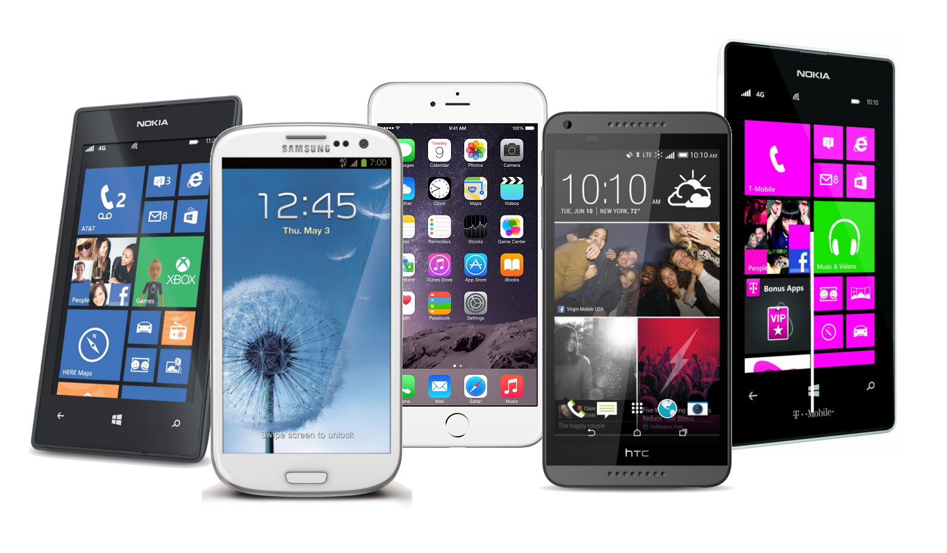
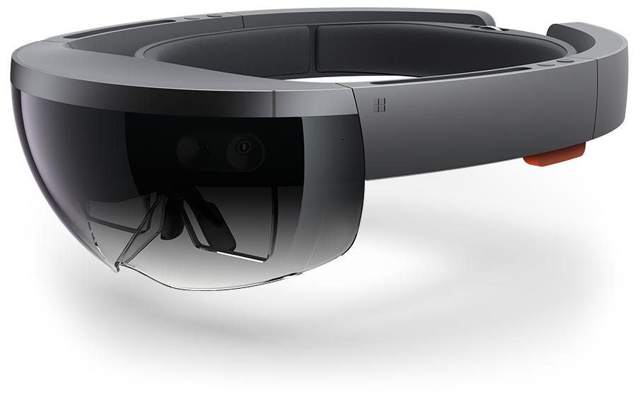


Mobile Devices
Hololens by Microsoft
Internet of things (IOT)

Slide 4
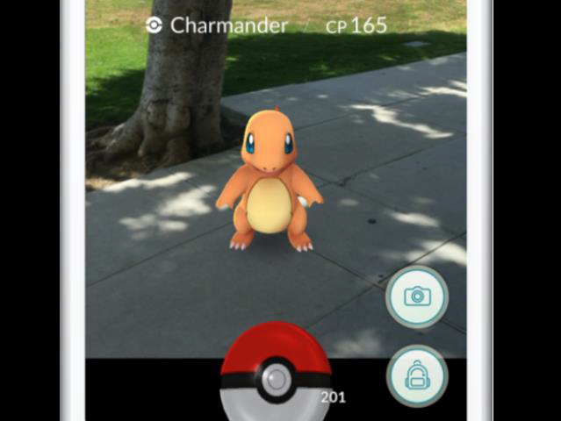

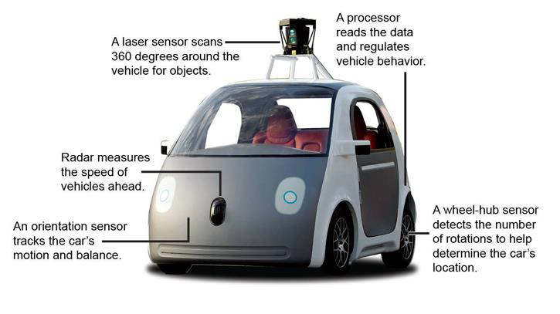

Applications of Mobile Devices

Slide 5
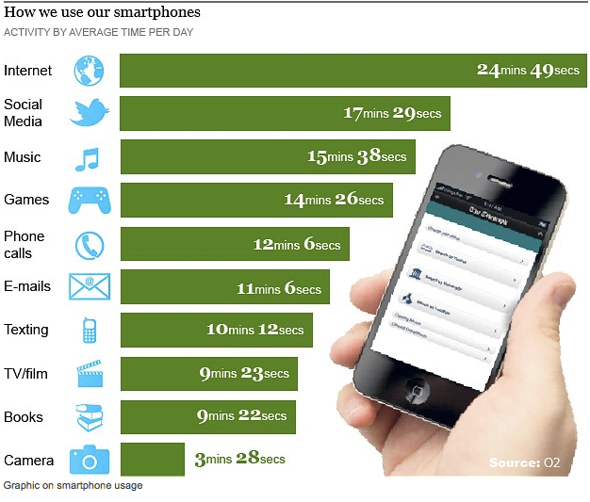
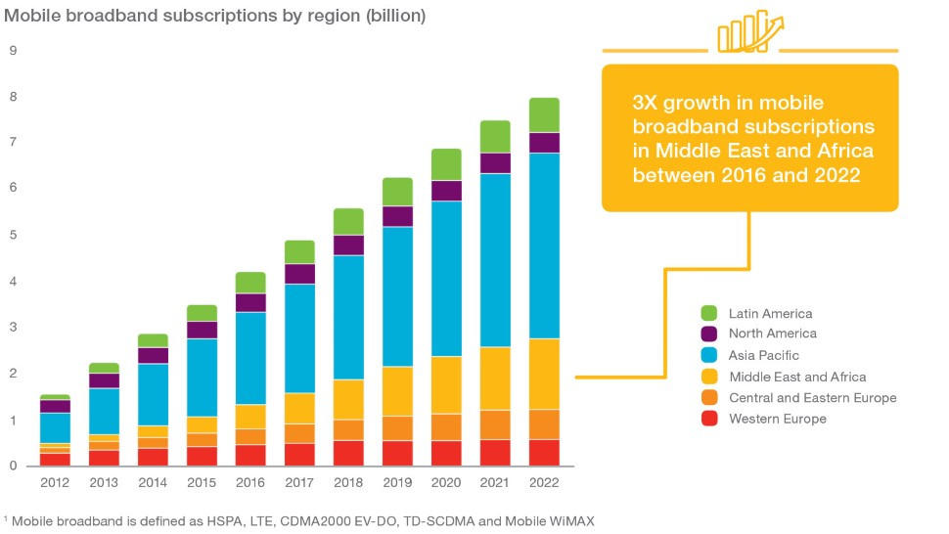
Trends & Usage
Growing subscriptions
Active sim cards
Used for entertainments and work purposes.

Slide 6
Challenges in Technologies
Hardware: Lighter, smaller, lower energy consumption.
Software & User interface: Heterogeneous devices, different interaction styles.
Network: Lower bandwidth, low reliability, higher delays, more jitter, different protocols
Location awareness.

Slide 7



Social Impacts
Privacy
Psychological Impact

Slide 8
Module Contents
Android Development, using Java (Week 1~8)
Lab sessions starts from Week 3.
Mobile Networking & Algorithm (Week 9~14)
No lab sessions
Mock exam paper
*I might adjust the schedule

Slide 9
Learning Outcomes
Have an understanding of the characteristics and limitations of mobile hardware devices including their user-interface modalities.
Be able to develop applications that are mobile-device specific and demonstrate current practice in mobile computing contexts
Have an appreciation of the design and development of context-aware solutions for mobile devices
Have an awareness of professional and ethical issues, in particular those relating to security and privacy of user data and user behavior.

Slide 10
Reference Books of this Module
Context-Aware
Stefan Poslad (2009). Ubiquitous Computing - Smart Devices, Environments and Interactions.
Thomas et al. (2009). Introduction to Algorithms (3rd edition).
Mobile application development
Official Android tutorials and manuals
Reto Meier (2008). Professional Android Application Development.
Mobile communication
Martin Sauter (2006). Communication Systems for the Mobile Information Society.
Jochen Schiller (2003). Mobile Communications (2nd edition).

Slide 11


Lecturers of this Module
Jianjun Chen
Jianjun.Chen@xjtlu.edu.cn
Office: SD541
Office hours: Check LMO module page.
Wanxin Li
Wanxin.Li@xjtlu.edu.cn
Office: SC242
Office hours: Check LMO module page.

Slide 12

Some Basics
Nested Classes

Slide 13
Nested Classes
Java allows you to define a class within another class. Such a class is called a nested class.
Nested classes are divided in to four categories:
Static: member classes declared as static.
Non-static: member classes not declared as static, also know as inner classes.
Local: classes declared in the body of a function.
Anonymous: local classes automatically declared and instantiated in the middle of an expression.

Slide 14
Static Nested Classes
class A {
static class B {
}
}
Defined along with the outer class.
Has similar access properties like other static members of the outer class.
A static nested class cannot refer directly to the instance variables or methods defined in its enclosing class.
But it can refer to static variables and methods.
Accessed using the enclosing class name:
OuterClass.StaticNestedClass obj =
new OuterClass.StaticNestedClass();

Slide 15
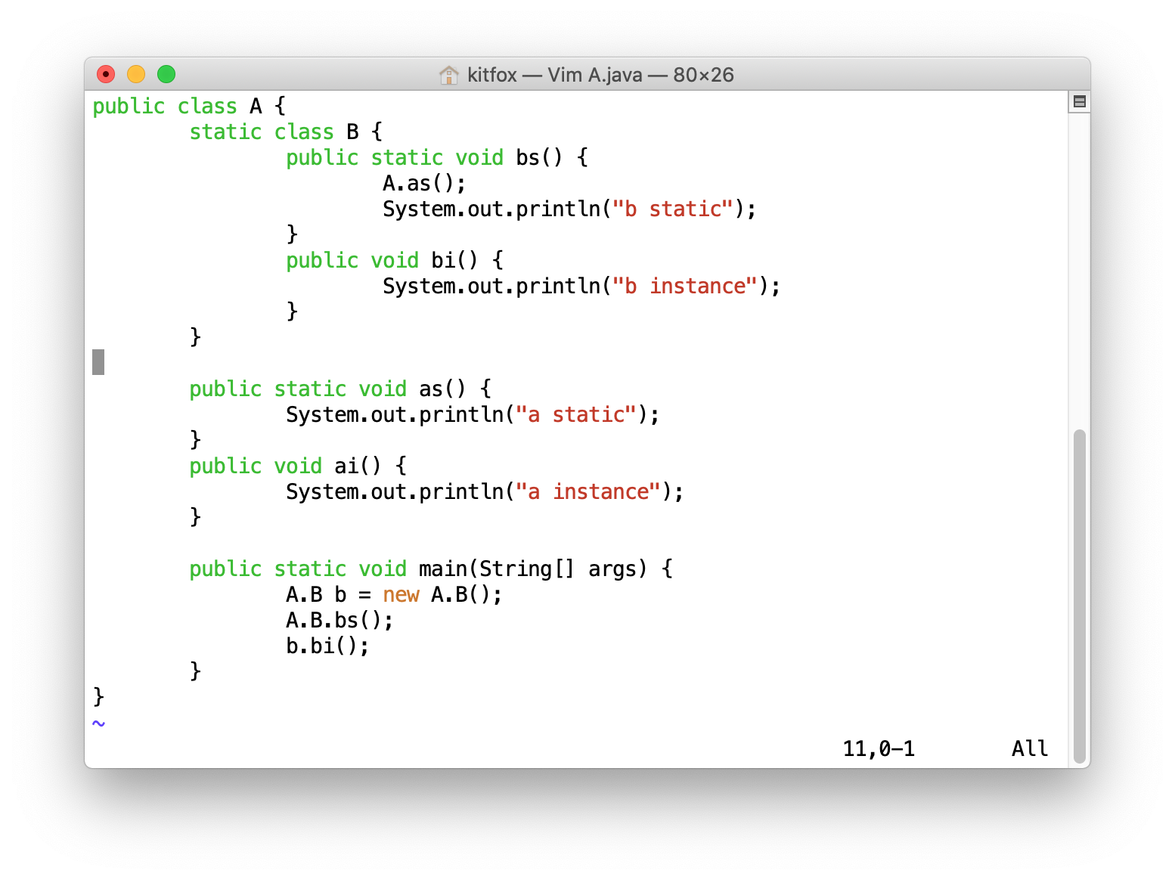
Static Nested Classes: Example

Slide 16
Non-static Nested Classes
Inner class is associated with an instance of its enclosing class and has direct access to that object's methods and fields.
You must create an object of the outer class first.
OuterClass outerObject = new OuterClass();
OuterClass.InnerClass innerObject = outerObject.new InnerClass();
Inner class cannot have static members.
It can have static final variables though.
class A {
class B {
}
}

Slide 17
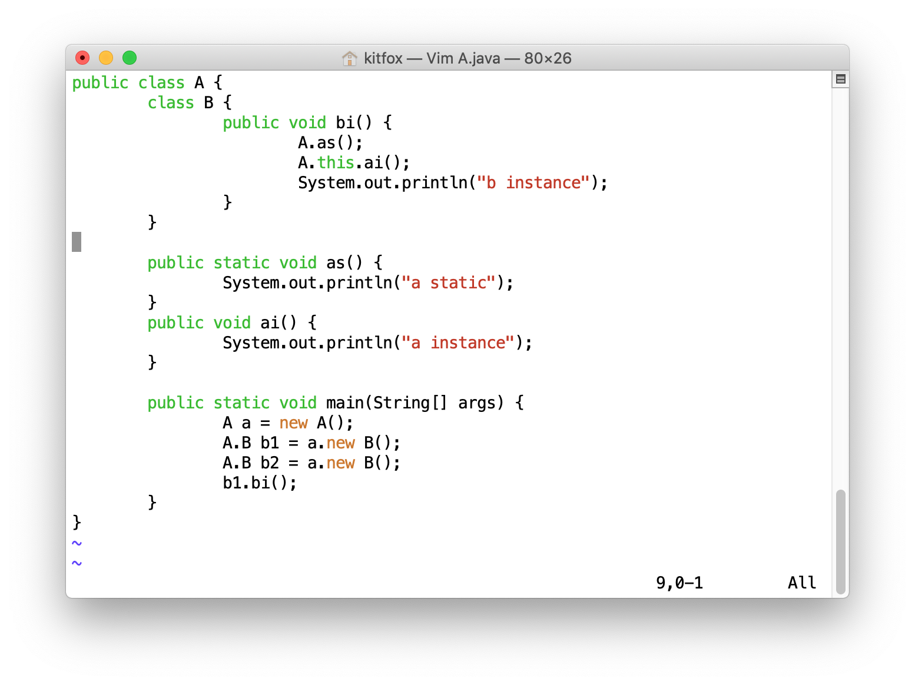
Non-static Nested Classes: Example

Slide 18
Nested Classes: Shadowing
Details: https://docs.oracle.com/javase/tutorial/java/javaOO/nested.html
public class A { int x = 1; class B { int x = 2; void testX(int x) { System.out.printf("%d, %d, %d\n", x, this.x, A.this.x); } } public static void main(String[] args) { A a = new A(); A.B b = a.new B(); System.out.printf("%d, %d\n", a.x, b.x); b.testX(3); } }
Notes:
What’s the design idea behind shadowing?

Slide 19
Question
When are the static final members of inner classes initialised?
Can you write a few lines of code to prove your point?

Slide 20
Variants of Inner Class
There are three variants of inner class:
Local classes
Anonymous classes
Lambda expressions
Local classes are defined in blocks { … }.
Anonymous classes are local classes without class names.
Lambda expressions are anonymous classes with only one function.

Slide 21
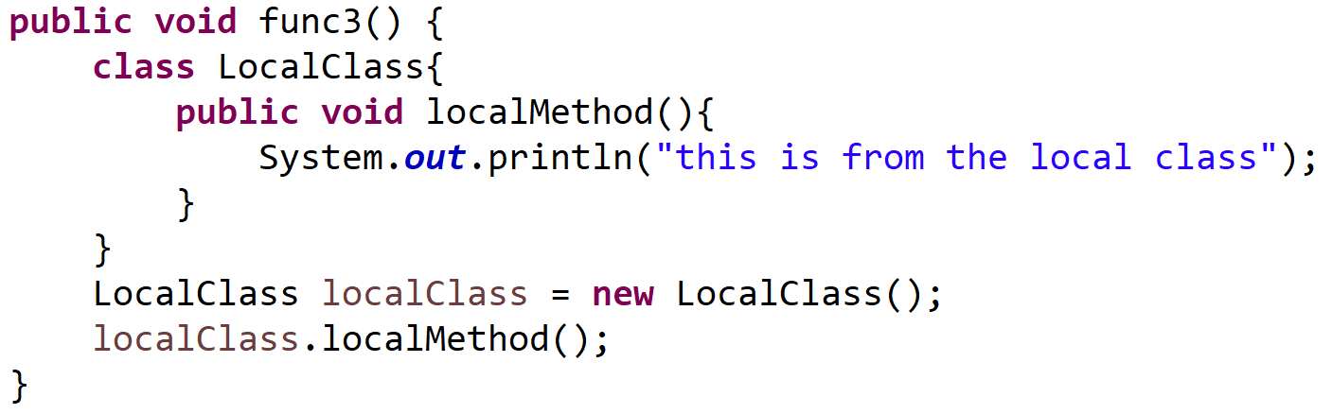
Local Classes
Local classes are similar to inner classes:
Cannot have static members.
Local classes can only access final local variables of the function.
Local classes in static methods can only refer to static members of enclosing classes.
If in non-static methods, they can access non-static members of the enclosing classes.

Slide 22
Anonymous Classes
An anonymous class is a local class without a name.
It is defined and instantiated (at the same time) in a single expression using the new operator.
public class MyExample { static interface Adder { int add(int a, int b); } public static int run() { return new Adder() { @Override public int add(int a, int b) { return a+b; } }.add(1, 5); } }

Slide 23
Anonymous Classes
An anonymous class must either
Extend another class
Or implement an interface
Format:
The constructor name is the same as the superclass name or the interface name.
*** You cannot define your own constructors.
new constructor_name(parameters) {
//inner class methods and variables
}

Slide 24

Lambda Expression
The previous example could be simplified by using the following Lambda expression:
https://www.w3schools.com/java/java_lambda.asp
public class MyExample { static interface Adder { int add(int a, int b); } public static int run() { return ((Adder) (a, b) -> {return a + b;}).add(1, 5); } }

Slide 25

Introduction to Android Development
Setting up, creating projects, testing apps

Slide 26
Smart Phone OS
Android
iOS
Windows
Blackberry
Symbian
WebOS

Slide 27
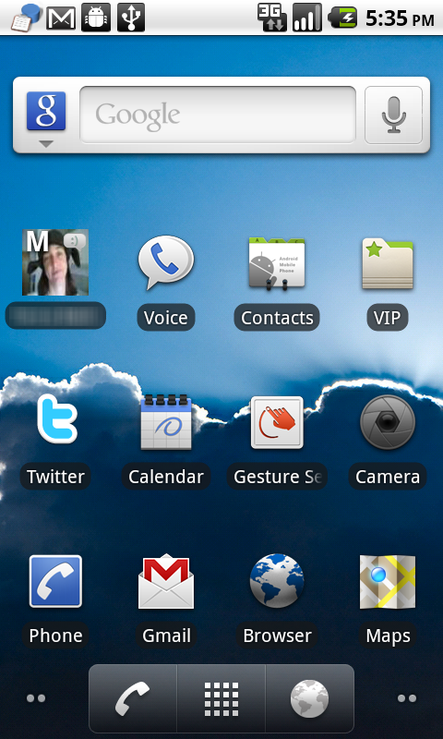
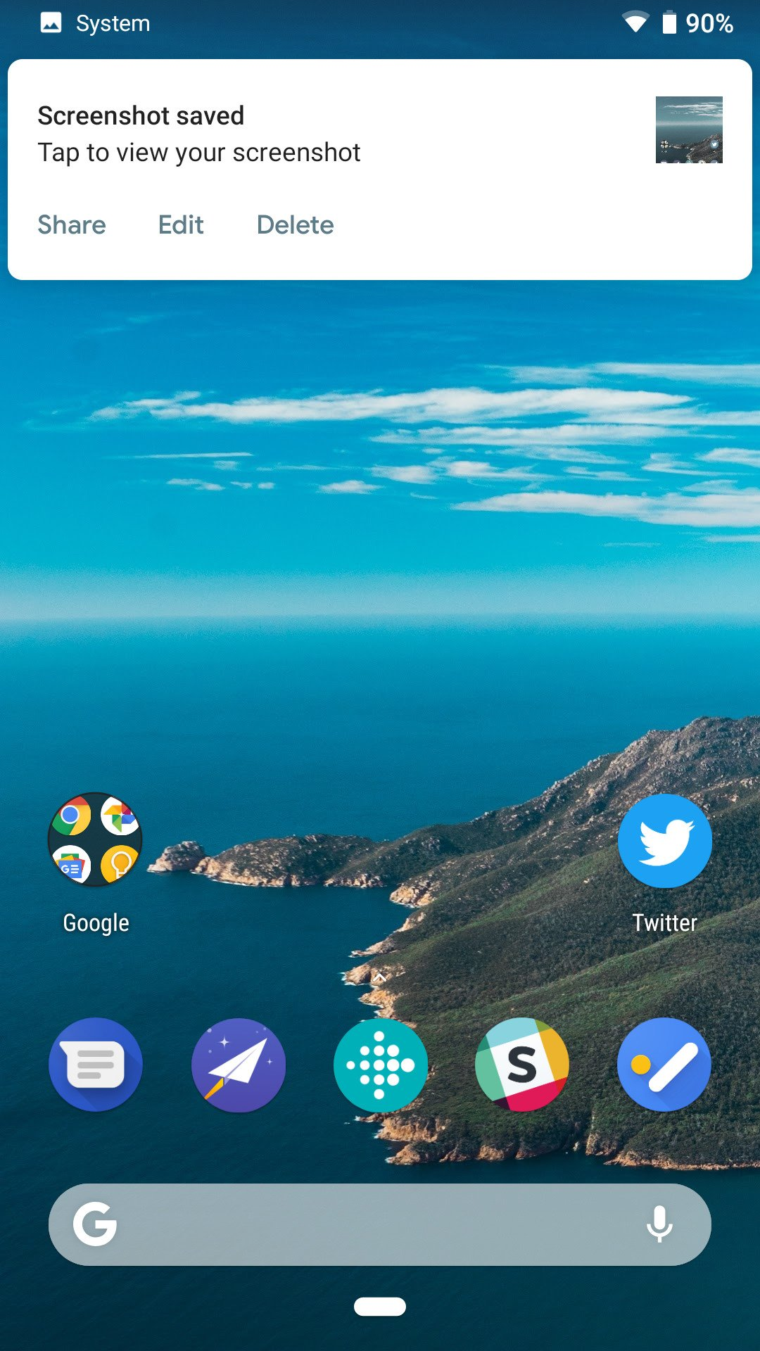
Android Platform
Linux-based operating system designed primarily for touchscreen mobile devices.
Open source: can be freely modified and distributed by device manufacturers, wireless carriers and enthusiast developers.
Unveiled in 2007, the first Android phone was sold in October 2008

Slide 28
VPN
It is recommended to get a VPN for this module.
Some resources are easier to download with a VPN.

Slide 29
Setting up Things
We will stick to using Android Studio (AS) throughout this module.
Eclipse probably works but don’t use it.
What will be covered in this lecture?
Android Studio set up.
The Android SDK.
The Gradle build system for AS.
A real or virtual Android device.

Slide 30
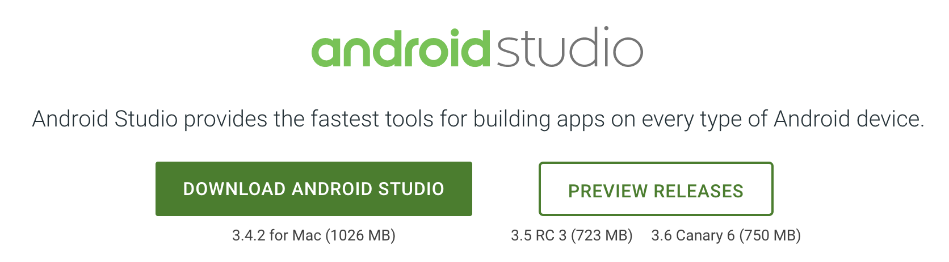
Getting Android Studio
Official website:
https://developer.android.com/studio/
Alternative website:
https://developer.android.google.cn/studio/

Slide 31
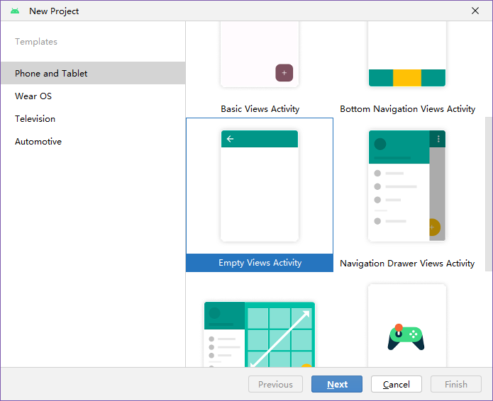
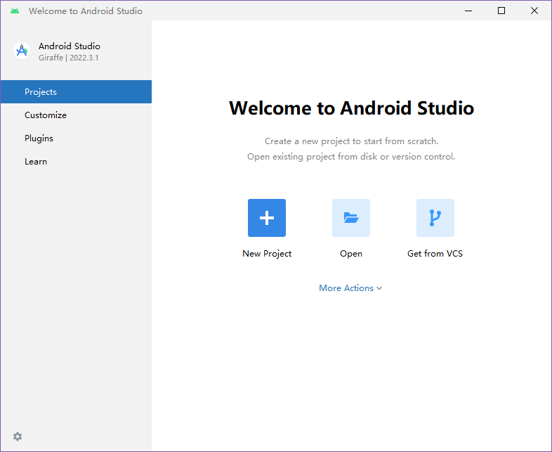
Creating a Project
Create a “New project” then select “Empty Views Activity”.
Feel free to experiment with other templates.

Slide 32
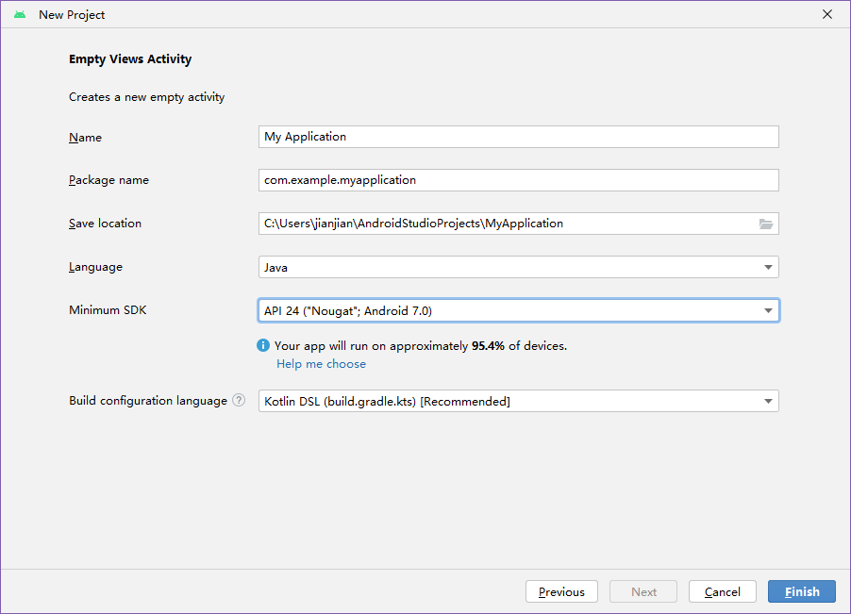

Slide 33
Android SDK and API level
The API decides how you call functions to access the service from the Android system. API is usually downward compatible.
E.g. Android 9 can run Android 4.X apps.
An app that requires higher version of Android API will run on less devices.
SDK: A set of tools that can provide different API libraries and developer tools.
Codename | Version | API level/NDK release
Android10 | 10 | API level 29
Pie | 9 | API level 28
Oreo | 8.1.0 | API level 27
Oreo | 8.0.0 | API level 26
Nougat | 7.1 | API level 25
Nougat | 7.0 | API level 24
Marshmallow | 6.0 | API level 23
Lollipop | 5.1 | API level 22
Lollipop | 5.0 | API level 21
KitKat | 4.4 - 4.4.4 | API level 19
Jelly Bean | 4.3.x | API level 18
Jelly Bean | 4.2.x | API level 17

Slide 34
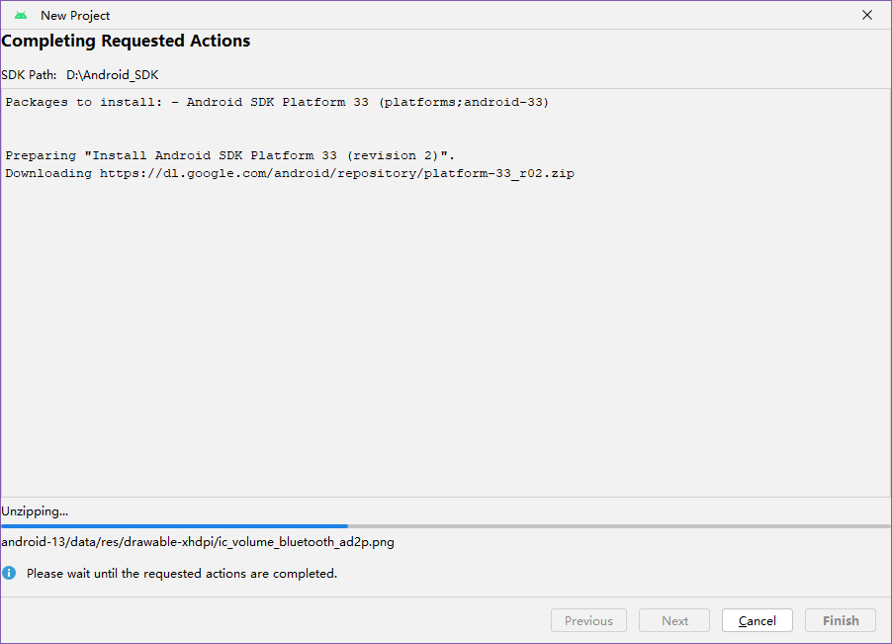
The IDE will download the newest SDK on the first startup.
If things are not being downloaded, you might need to use VPN
XJTLU Wi-Fi is a bad choice for downloading these.

Slide 35
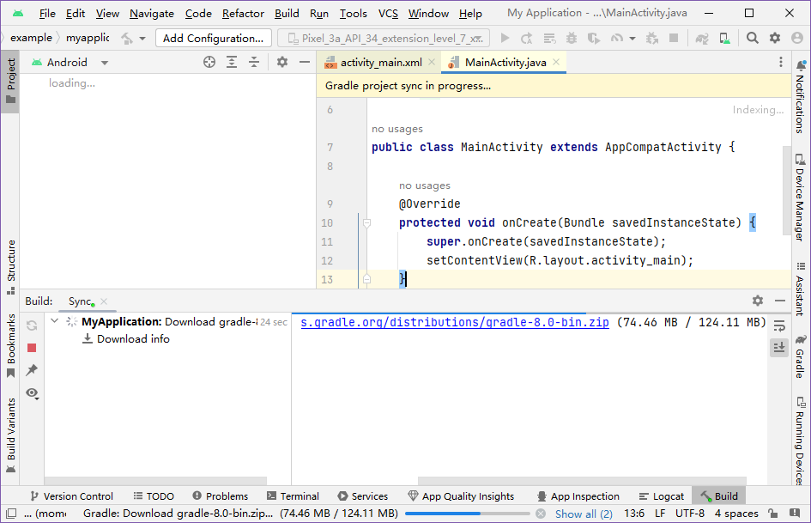

Slide 36
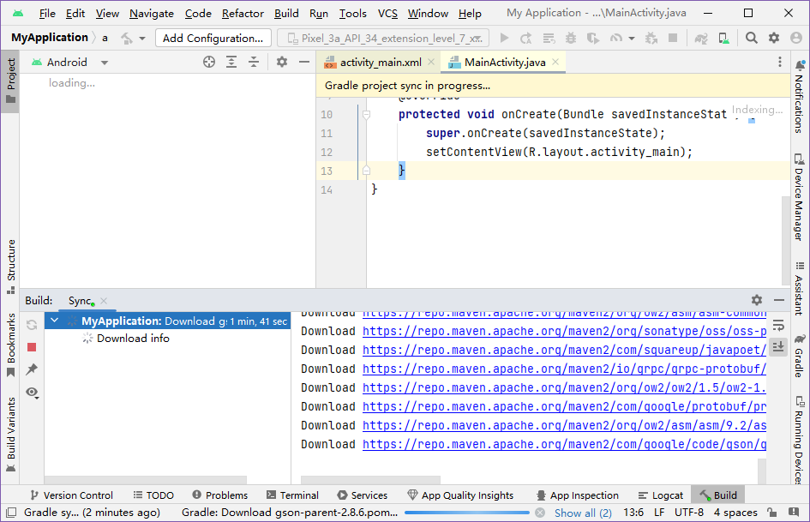
Gradle sync process starts automatically after creating a project. This process must be completed before you can do anything else.
With good internet/VPN, you should see a lot of files being downloaded the first time you create a project.

Slide 37
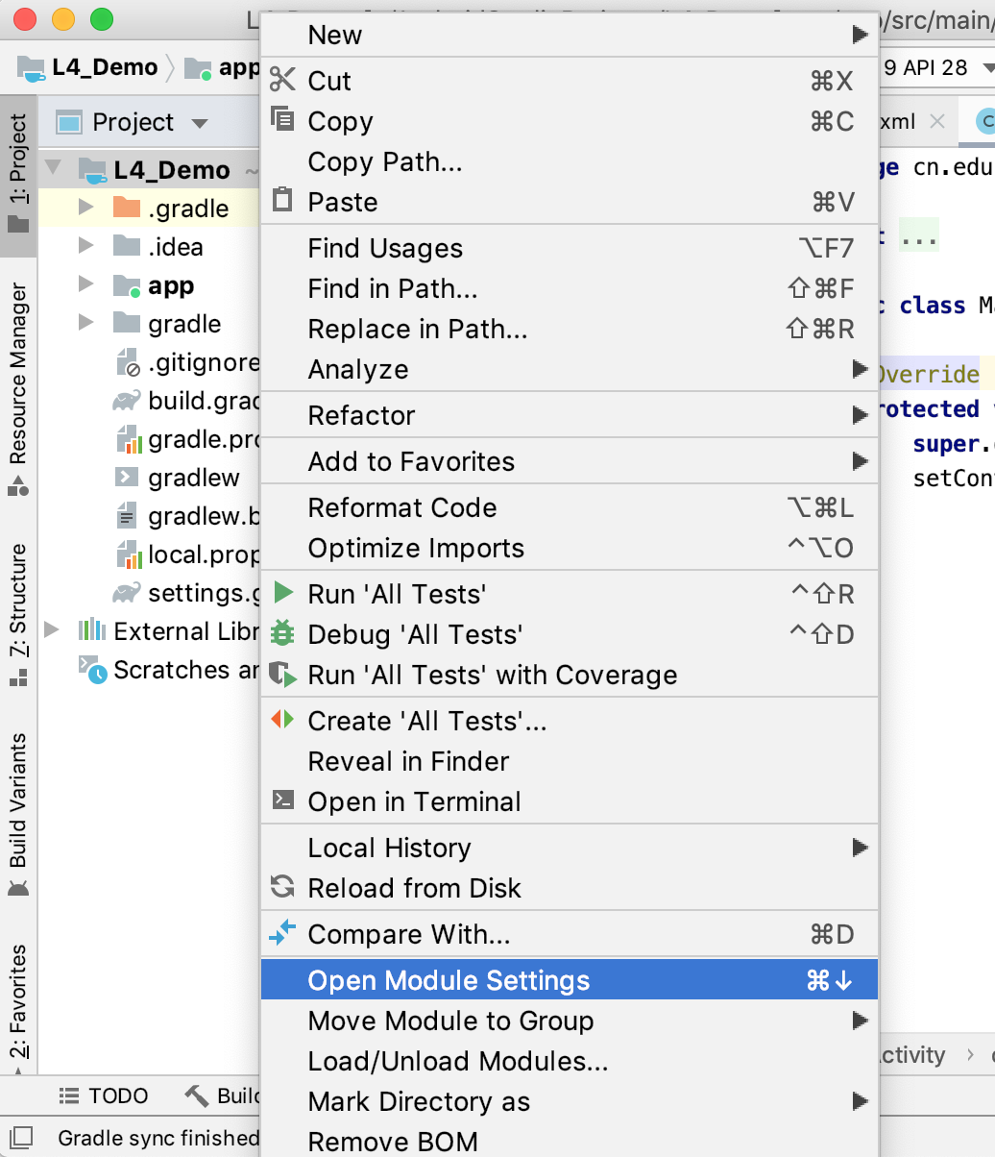
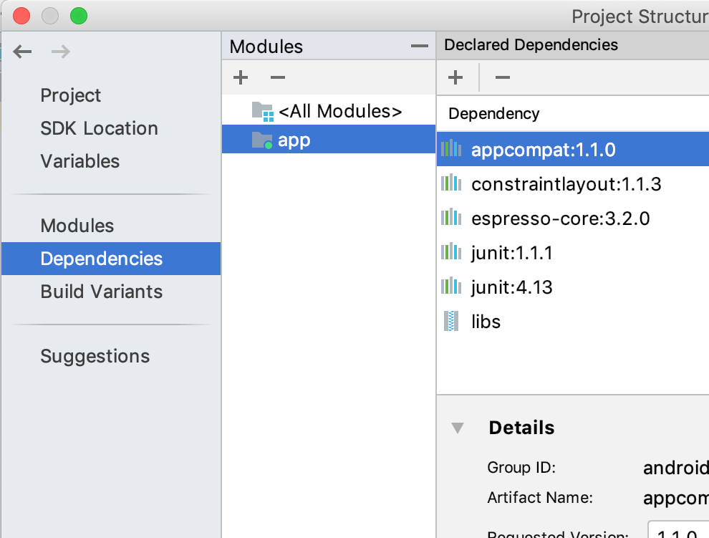
Gradle
What files are downloaded?
Right click on the android project, and select “open module settings”, you will see all modules required by your project
These mandatory libraries (and some other files) come from online repositories and must be downloaded by Gradle first.

Slide 38

Hello World
A walkthrough of the IDE

Slide 39
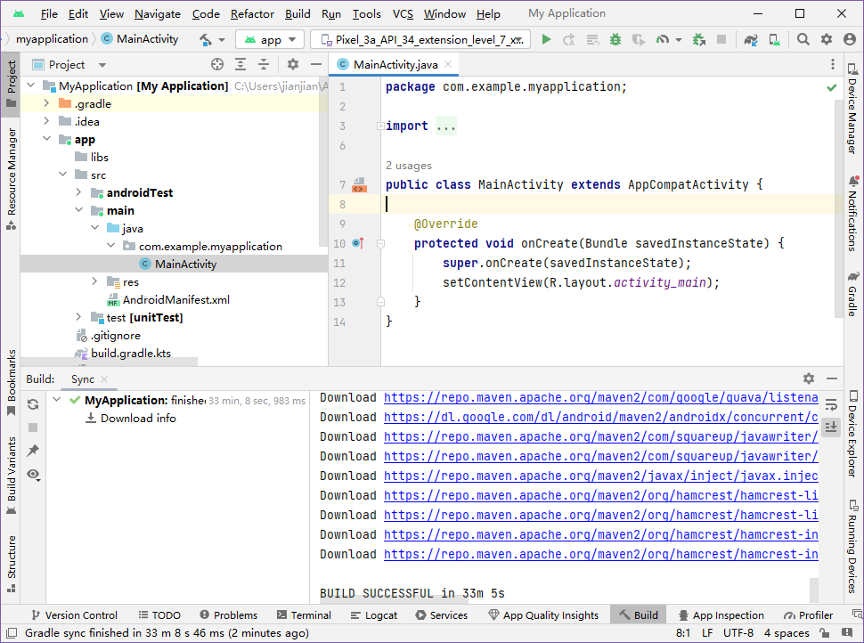

Slide 40
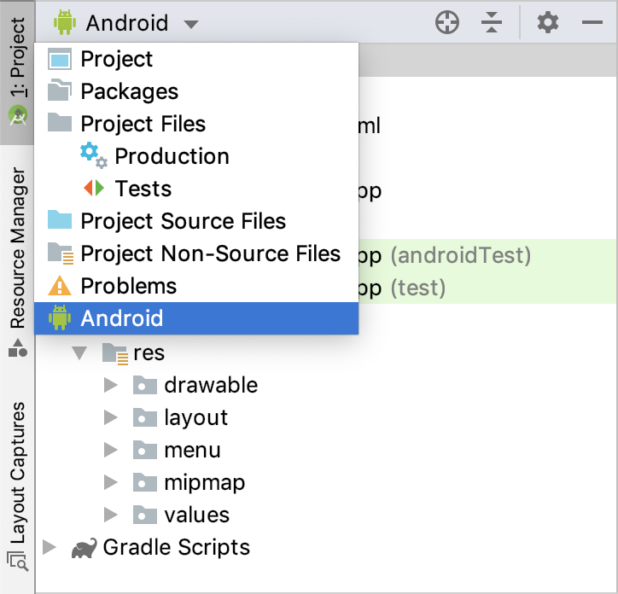
Project Window
There are several view options:
“Android” view is easier to understand.
“Project” view matches the folder structure in the file system (as seen in your file explorer)

Slide 41
Project Folders
Manifests/AndroidManifest.xml: Basic information of the app, such as app name, its activities, permissions required etc..
Java: Your source code and test code.
res: Various resources used by your app
mipmap: App icons.
drawable: Images (bitmaps, jpegs, pngs) used in your app.
values: store the values for the resources, such as color, styles, dimensions etc..
layout: UI layouts.
Gradle scripts: Settings and scripts for the build system, such as the location for SDK.

Slide 42
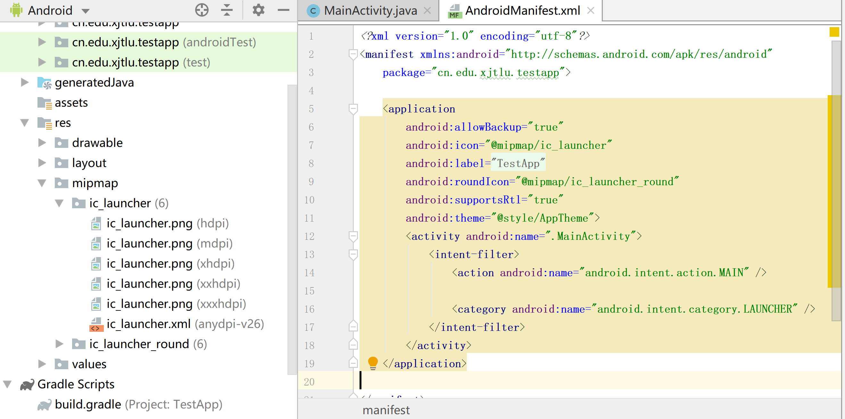
Manifest File
This file stores the core settings of your app, such as the permissions required to run this app, and its Activities.

Slide 43
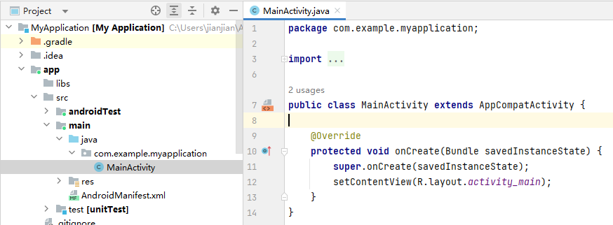
The “Main” Activity
The entry point of your app is “MainActivity”.
Currently, it only loads its UI and does nothing else.
Details of Activity will be explained in the next lecture.

Slide 44
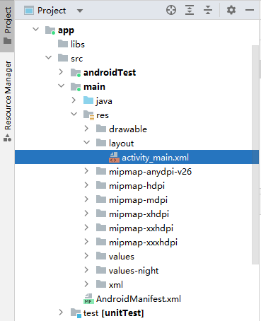
Layout Files
Layout files are XML files that describe what widgets are used and how are they placed on the screen.
Each activity is usually associated with one Layout file.

Slide 45
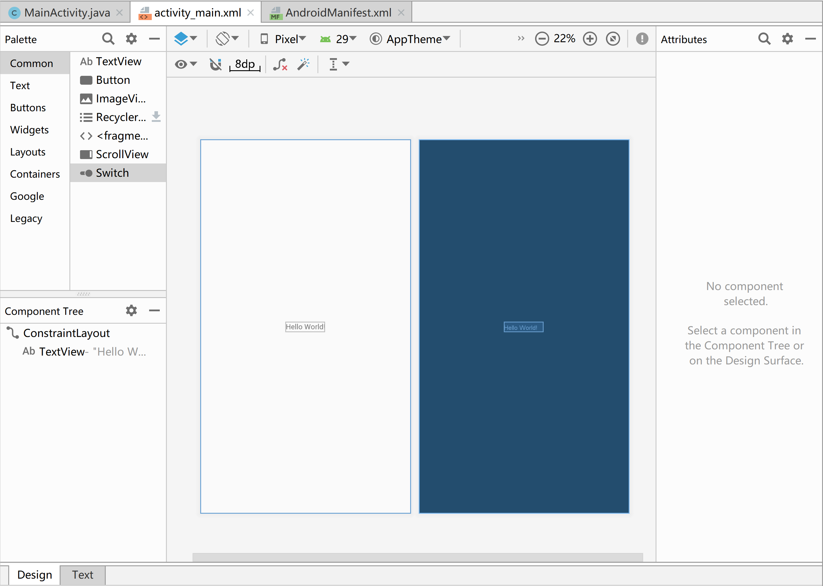
Layout Files: Designer

Slide 46
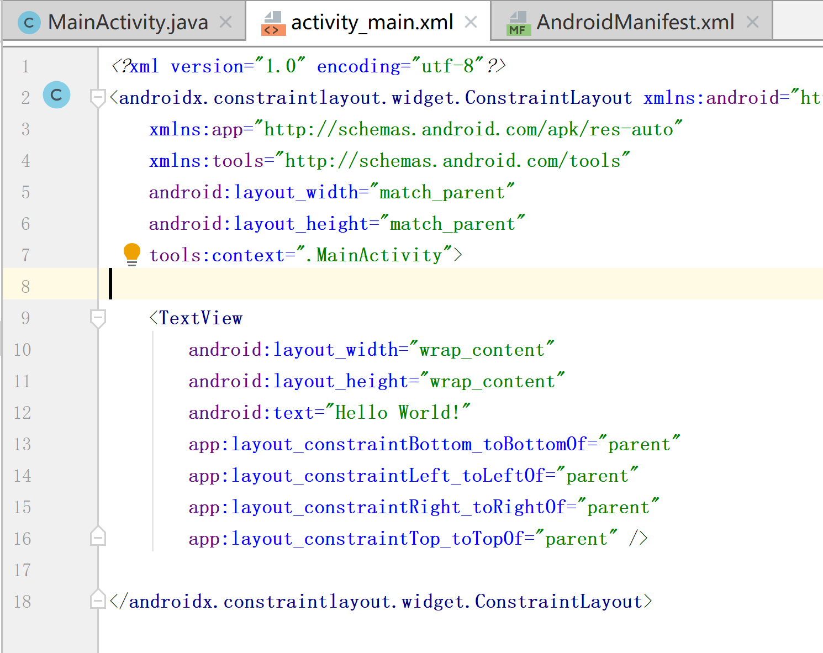
Layout Files: XML Content

Slide 47
Running the Example
Android projects are compiled and packaged into a .apk file, the container for your application.
To run an application on an emulator or device, the application must be signed using debug (or release) mode.
Application signing ensures that one application cannot access any other application except through well-defined IPC

Slide 48
Running Android Apps
By default, each application
is assigned a unique Linux user ID
executes in its own Linux process
Android Apps are not Linux apps
Android manages process creation & shutdown
Starts process when any of the application's code needs to be executed
Shuts down when process is no longer needed, and system resources are required by other applications
A major difference between applications on PC and apps on mobile devices.
Notes:
This page seems irrelevant but It matters when you implement apps that call activities from other apps.
<activity android:name=".MainActivity" android:exported="true"> <intent-filter> <action android:name="android.intent.action.MAIN" /> <category android:name="android.intent.category.LAUNCHER" /> </intent-filter> </activity>
The “exported” flag here indicates whether the given application component is available to other applications. If false, it can only be accessed by applications with its same user id (which usually means only by code in its own package)
So you do need to understand this page a bit.

Slide 49
Android Virtual Device (AVD)
To test the app you are developing, you’ll need an android device, either virtual or real.
We have Xiaomi tablets this year. But the number is not enough for everyone. They will be used for the group project.
If you have an Android Phone, you can use your phone.
Android Virtual Device (AVD):
Menu->Tools->AVD Manager
Toolbar Button

Slide 50
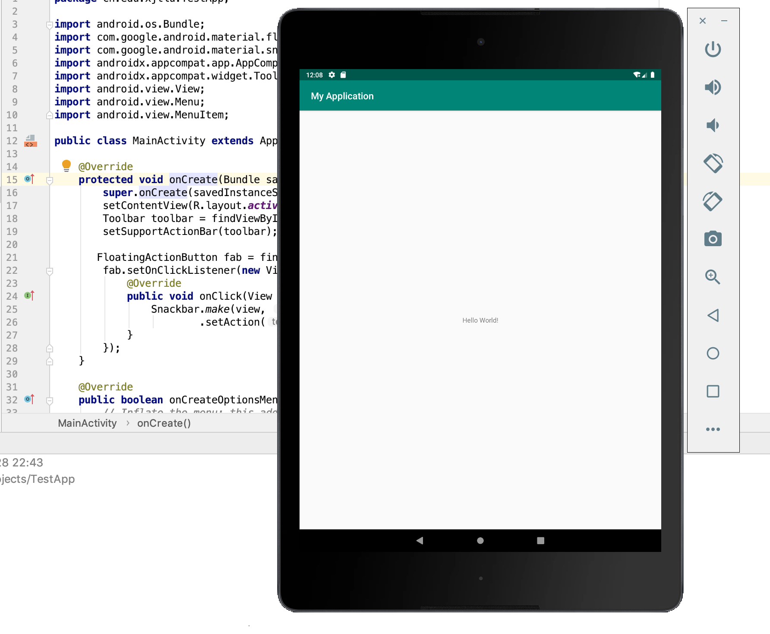

Slide 51
Connecting Real Devices
Connect your device to your development machine
Enable USB debugging in your device
Open the Settings app -> About phone.
Tap Build number 7 times.
Return to the previous screen to find “Developer options”.
“Developer options” -> “Enable USB debugging”.
Run the app on your device as follows:
In Android Studio, click Run in the toolbar.
In the Select Deployment Target window, select your device, and click OK.
Android Studio will install the app on your device and starts it (may take a while when starting for the first time!). You should see the app on your device.

Slide 52
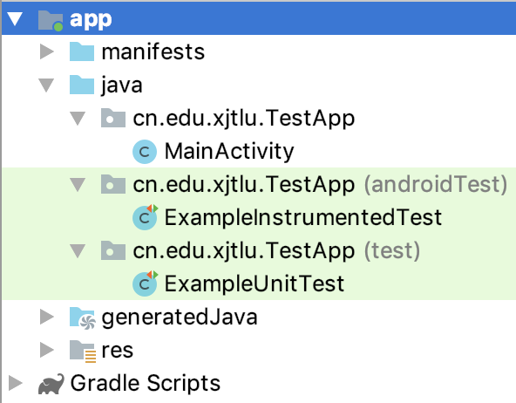
Writing Tests
Test cases are placed along with your main App source in the project view.
Unit tests run locally in the IDE and can help check the correctness of single components.
Instrumented unit tests are tests that run on physical devices and emulators
https://developer.android.com/training/testing/unit-testing/local-unit-tests
https://developer.android.com/training/testing/unit-testing/instrumented-unit-tests

Slide 53
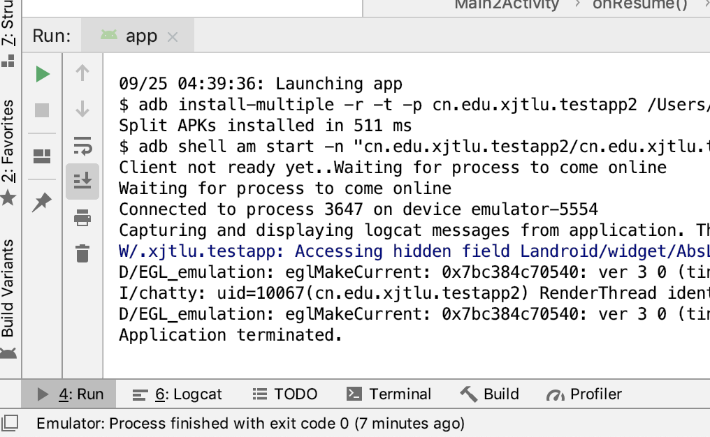
* Console output
Your console output (System.out) can be seen from the “run” window in Android Studio.
You should normally use Log class instead.
https://tutorial.eyehunts.com/android/android-logcat-log-v-log-d-log-log-w-log-e-use-one/

Slide 54
Finally
The official manuals and guides can be found at:
https://developer.android.com/guide
or
https://developer.android.google.cn/guide

